Slide 1
Washington State Healthcare Provider Demographics
Heath Brinkman

Slide 2
How do we improve care for all Washington residents?

Slide 3
What does our current healthcare workforce look like?
Washington Health Workforce Survey
69,956 Active Workers
34 Different Identified Racial Identities
49 Different Credential Types
Age range from 18-112
Average Age: 42
https://data.wa.gov/Health/Washington-Health-Workforce-Survey-Data/cvrw-ujje

Slide 4
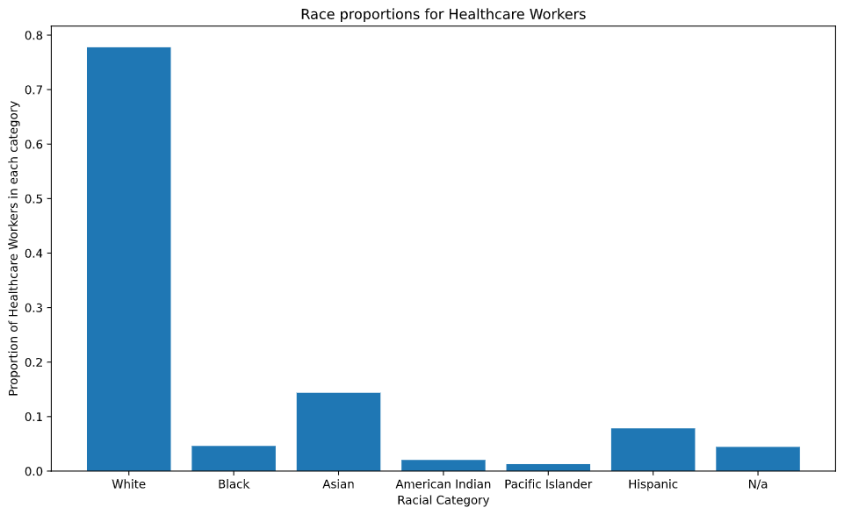

Slide 5
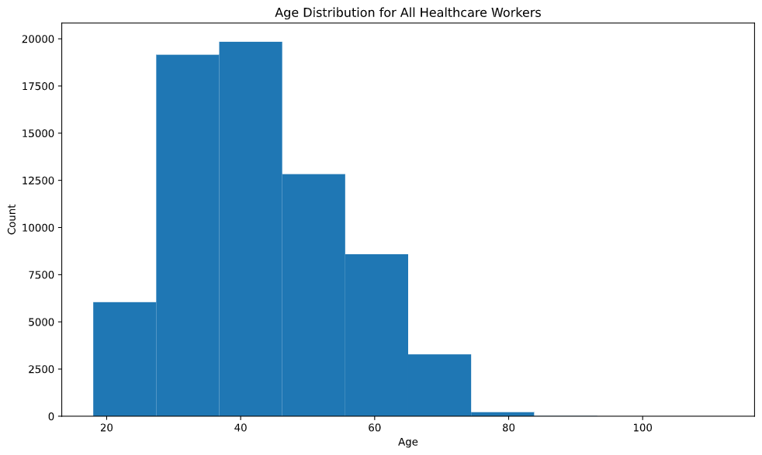

Slide 6
What insights can we gain from this survey?

Slide 7
Disparities in age, representation and skill sets
Improving racial and ethnic representation in the healthcare workforce allows for better care and improved patient satisfaction
Caregivers with foreign language skills are able to treat more patients and reduce strain on hospital translation resources
Caregivers with longer experience in the workforce may be highly skilled, but are often not up to date on current medical techniques, which can reduce the effectiveness of treatment and lead to higher mortality rates
https://www.ncbi.nlm.nih.gov/pmc/articles/PMC1124573/
https://onlinelibrary.wiley.com/doi/full/10.1111/jgs.15939
https://www.statnews.com/2017/05/16/doctor-age-patient-mortality/

Slide 8
Hypotheses
White caregivers will be significantly older than their non-White counterparts
Non-White caregivers will be significantly less experienced than their white counterparts
The proportion of non-White caregivers with foreign language skills will be significantly higher than their non-White counterparts
The proportion of White caregivers with Physician/Surgeon credentials will be significantly higher than their non-White counterparts
The proportion of non-White caregivers with CNA credentials will be significantly higher than their non-White counterparts

Slide 9
Age Disparities

Slide 10
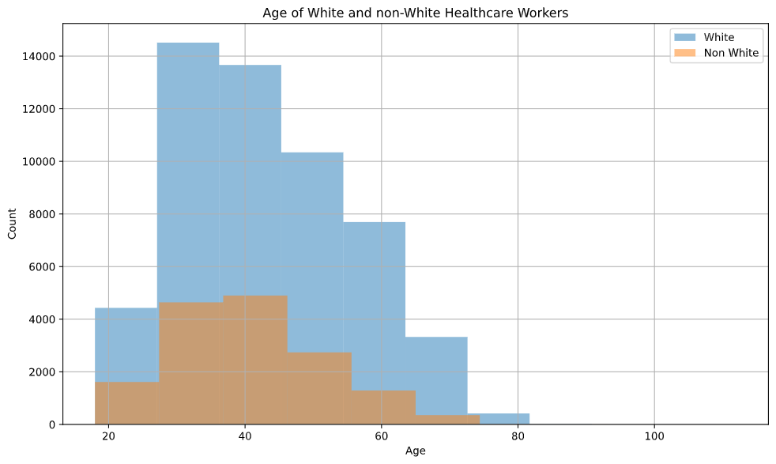

Slide 11
Mean Difference of 2.9 Years
t-test results: p-value=1.76e-130
95% CI: Upper Confidence Interval: 3.1, Lower Confidence Interval: 2.7
Notes:
95% CI between 2.7 and 3.1

Slide 12
Experience Disparities

Slide 13
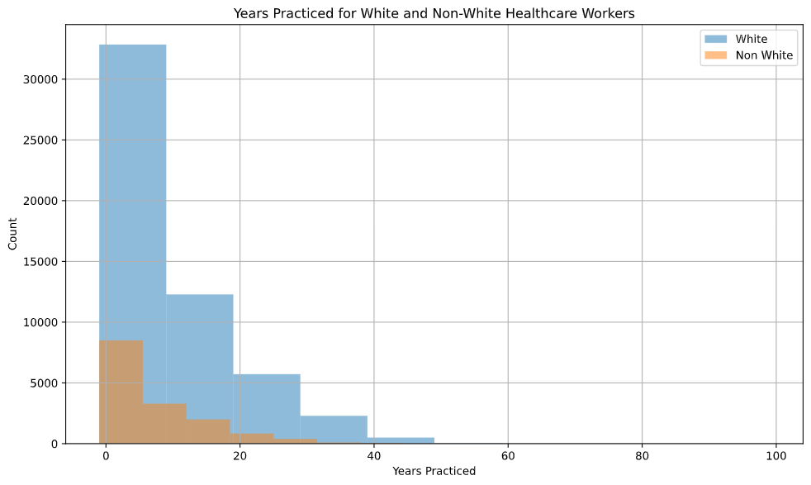

Slide 14
Mean Difference of 1.9 Years
Mann-Whitney-U Result: p-value=1.99e-66

Slide 15
Language Barriers

Slide 16
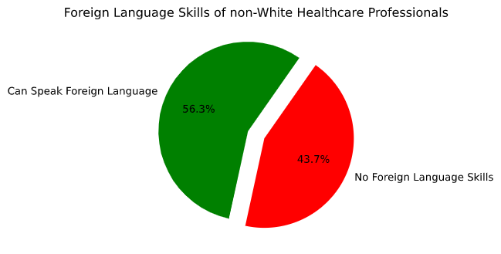
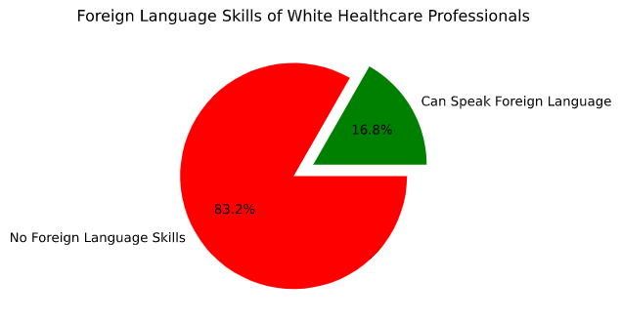
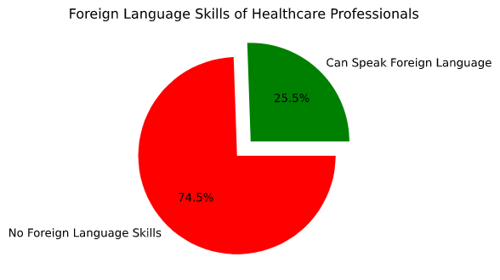
Population Language Skills
Highly Significant Difference
z-test: p-value <<<<0.05

Slide 17
Physician Credentials

Slide 18
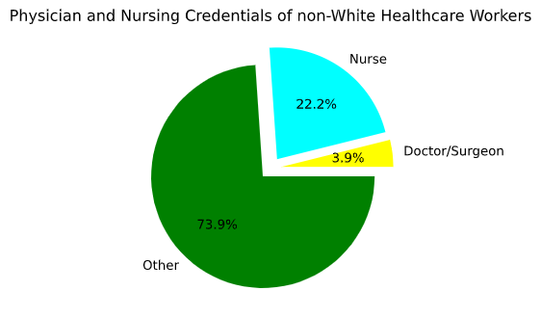
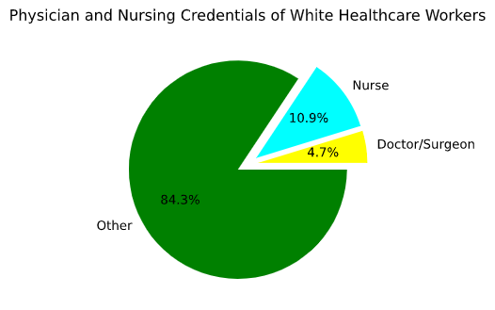
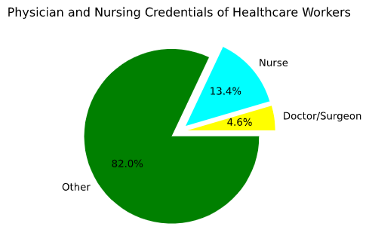
CNA and Physician Credentials
Highly Significant Differences
z-tests: p-values <<<<0.05

Slide 19
Takeaways
White doctors tend to be older, have fewer foreign language skills but more experience
Non-White doctors tend to be younger, have more foregin language skills but are less experienced
Nurses are more likely to be non-White

Slide 20
Next Steps
Create foreign language trainings targeted at white healthcare professionals to increase their ability to communicate with patients and improve care
Provide trainings and scholarships to increase non-White representation in the healthcare workforce, improving health outcomes for non-White patients
Create training programs for older workers to ensure quality of care does not decrease as their age increases

Slide 21
Questions?

